Slide 1
“VAAFM - presentation from farm inspectors about what happens on a VAAFM inspection, what are inspectors looking for, how to support farms before, during, and after an inspection and with a Corrective Action Letter”

Slide 2
Agency of Agriculture Water Quality
Regulatory Visits
1. What is a regulatory visit?
2. Before the visit
3. During the visit
4. After the visit

Slide 3

Regulatory visits- 3 primary types*
*Inspections
Production areas (Anywhere feed or waste is stored, or animals are housed)
Occurs on a consistent schedule ( LFO- every year, MFO- every 3 years, CSFO- every 7 years)
Initiated by an allegation via a complaint
Focused on assessing an allegation
NMP and records check
Broad in scope and intended to be comprehensive
Narrow in scope
Field checks
*Investigations
All visits are generally conducted in pairs.

Slide 4
Regulatory visits- 3 primary types*
*Enforcement/ Programmatic follow-up (EFU/PFU)
Intended to follow-up on a previous concern
Narrow in scope
May be conducted in combination with other visits
Joint CAFO visits
Joint visits with both the Agency of Natural Resources and the Agency of Agriculture
ANR will be the lead on these visits

Slide 5
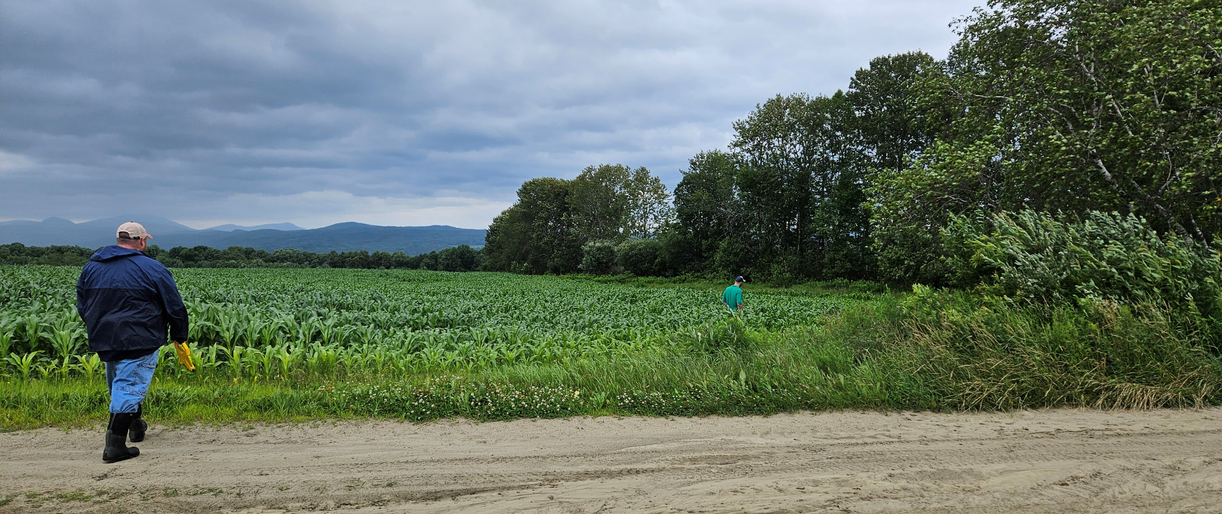
The role of inspectors is to observe and document conditions in the field.
Enforcement decisions are made after an inspector’s report is completed; decisions are made by our enforcement committee.
An inspector may be willing to share their perspective on what they think the outcome of a visit may be.
In 2025:
The inspection team conducted ~225 visits and wrote ~330 reports

Slide 6
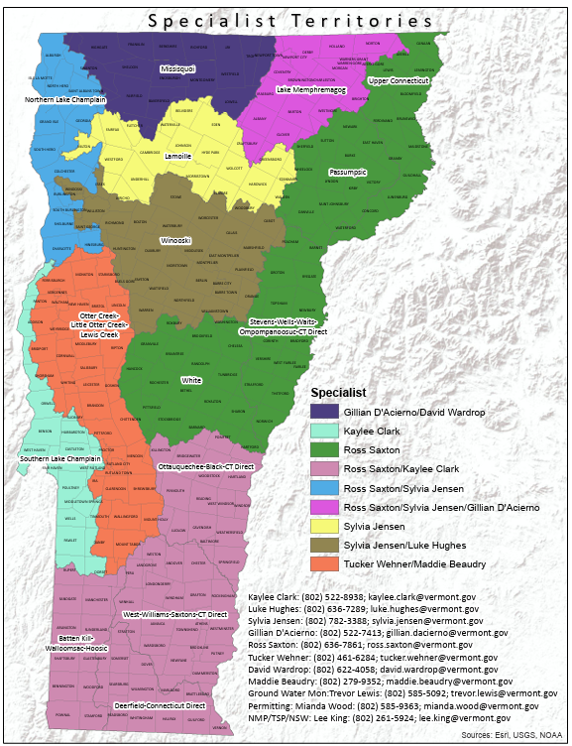

Slide 7
Before all visits
Communication (email, phone, text, or a via TSP) and acknowledgement by the farm that a visit is required; sometimes multiple visit types are needed
Communication to the farm about information that will likely be needed (checklist available)
Explanation of the purpose of the visit and who will be present

Slide 8
Before inspections
Inspectors aim to schedule inspections 2-4 days in advance; on occasion, a visit is scheduled a week or two in advance
Inspectors can estimate how long an inspection can take for a farmer, but it does vary considerably depending on the farm size, visit types, complexity, and unforeseen observations
What a farmer should compile ahead of time:
Current NMP
  If a current NMP has not been developed, the most recent soil tests and manure analysis should be available
Spreading and fertilizer records from the prior crop year (unless previously submitted)
Any import and export records from the prior crop year

Slide 9
Before EFU/PFUs
An inspector will explain what is being followed-up on and what will be observed
Inspectors conduct follow-up visits on a timeframe that aligns with program enforcement needs and that is efficient with other field work
EFUs and PFUs can happen during the same visit as an inspection or investigation
The farm may need to provide CURRENT crop year records, including crop yields and/or the farm’s NMP
With permission from the farm, TSPs may request enforcement action details from an inspector

Slide 10
Before investigations
Inspectors will explain to the farmer the allegation and what will likely need to be assessed
Inspectors are expected to conduct investigations within ~5 days of their receipt of a complaint
VAAFM and/or ANR receives a complaint online or by phone
The farm may need to provide CURRENT crop year records and NMP
Other parties may be involved. Ex. Custom applicators, other farms or property owners
The agency is responsible for keeping complainants anonymous

Slide 11
During inspections
Inspectors will observe farm assets and areas where wastes could be found
Water samples (wells and springs) will likely need to be taken
Inspectors will take pictures to represent the inspection, but we try our best to limit the number of photos taken
Inspectors will complete the following: NMP and records review*, production(s) area observation, three field or pasture checks, and water sampling.
*LFOs submit NMPs annually, which can be reviewed before the visit

Slide 12
During EFUs/ PFUs
Inspectors will need to see any information relevant to the allegation. This can include: records, assets, NMP, etc.
If an inspector observes an unrelated issue, it will need to be documented
Inspectors will take pictures of areas where an issue both has or has not been resolved.

Slide 13
During investigations
Inspectors will need to see any information relevant to the allegation. This may include: records, assets, NMP, etc.
If an inspector observes a water quality issue that is unrelated to the complaint, it will need to get documented
Inspectors will take pictures whether there is an issue found or not. The absence of an issue needs to be documented during these visits
Water samples (wells or springs) may be needed as part of the visit

Slide 14
Some conditions inspectors look for
Production area
Field checks
Waste running off
Pooling of waste
Erosion
Waste in pipes (inlets/outlets), ditches, conveyances
Dead vegetation
Structural failures
Improper management of waste or structures
Perennial buffers
Waste runoff
Overapplication of manure
Erosion
Animal access to surface water
Manure spreading setbacks

Slide 15
After all visits
In general inspectors offer to debrief about their observations at the end of a visit, in-person or otherwise. This debrief does not always occur due to farm preference or other factors.
Inspectors are expected to finalize reports within 90 days of the visit and mail them to the farm. Reports can be emailed if that is the farm’s preference.
All reports go through a minimum of two levels of review
Our reports captures observations from the day of the visit but can include details from later. Ex. Manure records submitted after the visit, or trees cut down on a manure pit berm.
After reports are completed and mailed, they are reviewed by our Enforcement committee if necessary.
In general, our enforcement process has been taking from 4-6 months from the date of a visit until a farm receives an enforcement action.

Slide 16
Types of Enforcement Actions
Letter of Warning (LOW)
Corrective Action Letter (CAL)
Notice of Violation (NOV)
4991 Meeting
Assurance of Discontinuance (AOD)
Mandatory Corrective Action Order (MCAO)

