Slide 1
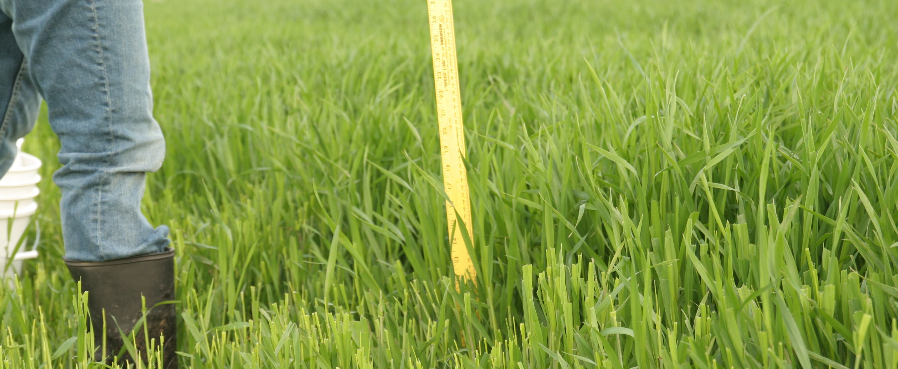
Cover Crops as Forage

Slide 2
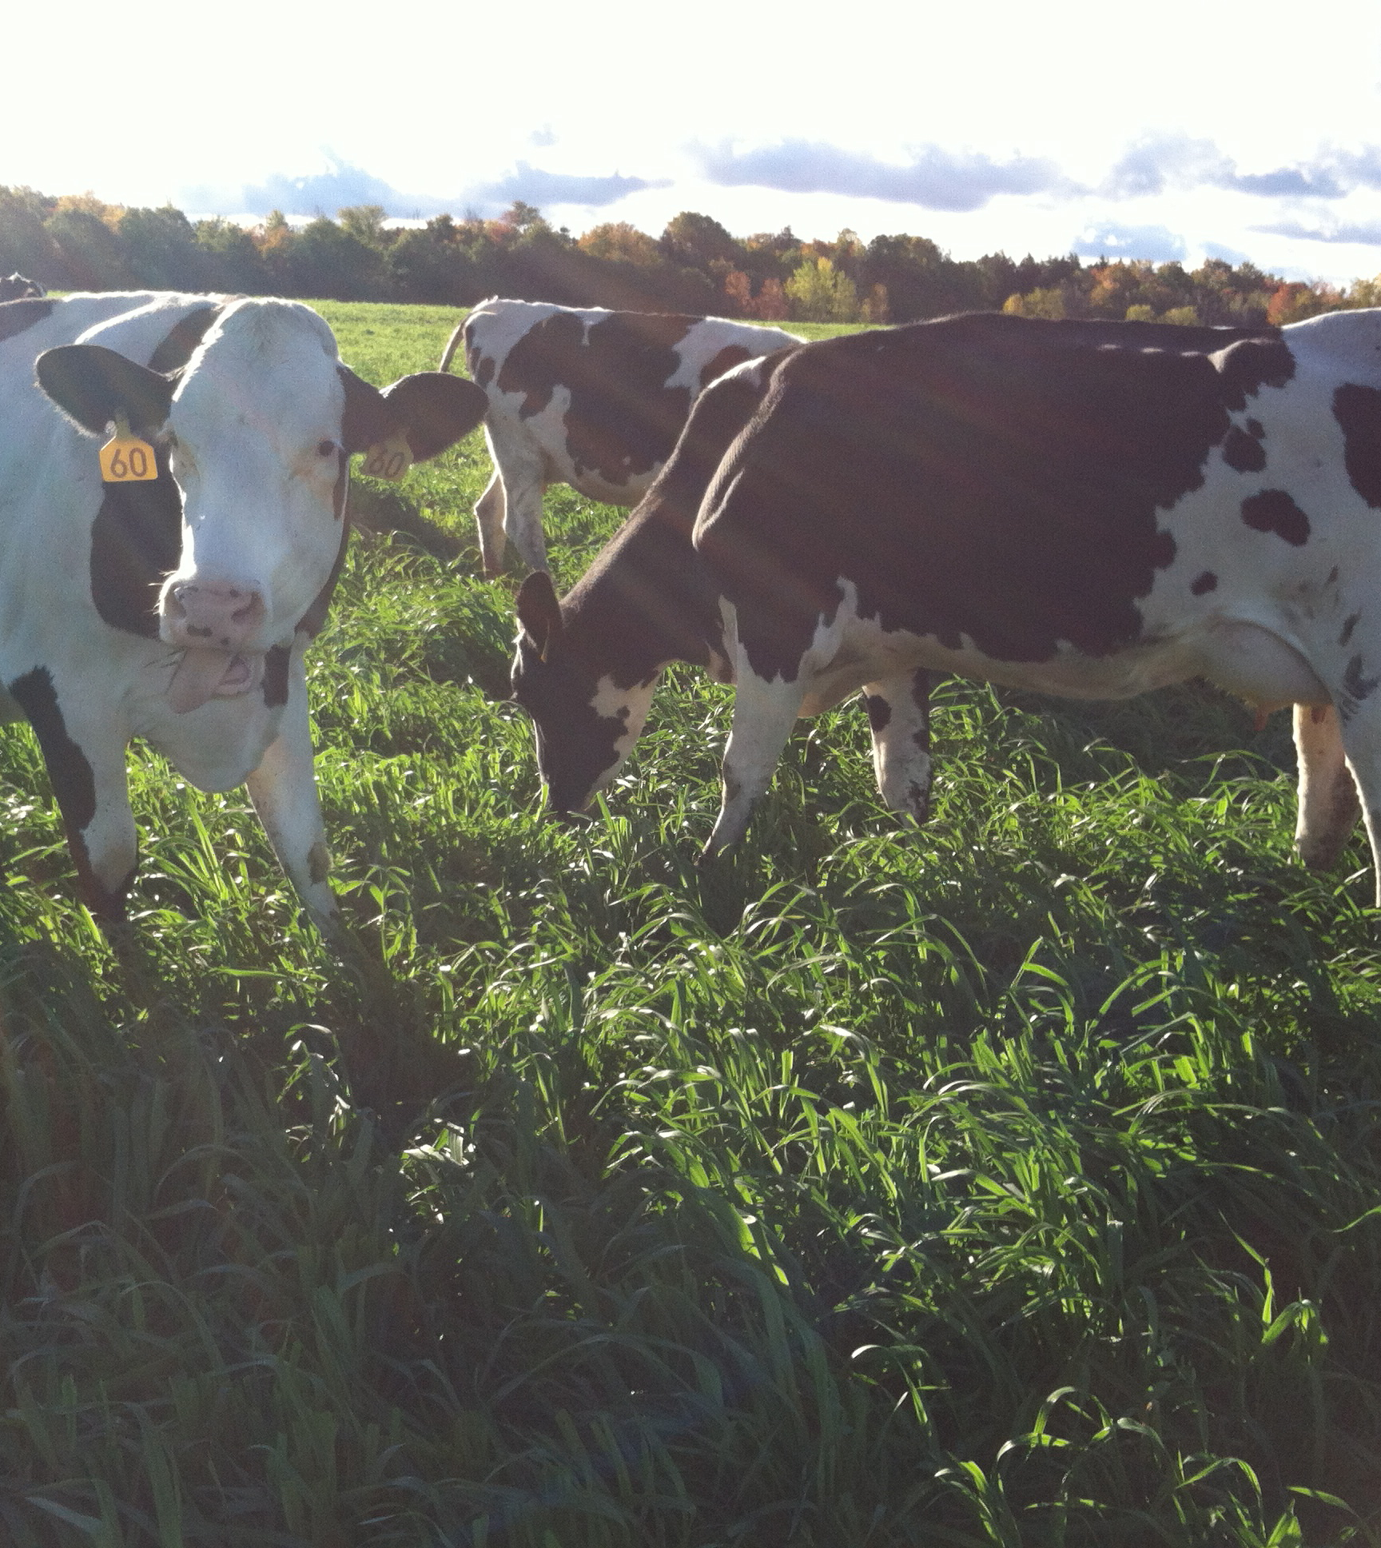
Why Consider Cover Crops as Forage
Drought tolerant
Cold tolerant
Fill gaps in feed (summer slump)
High biomass and quality crop
Multipurpose
  Grazing
  Silage/balage
  Grain/seed
Notes:
Why we might grow annuals.

Slide 3
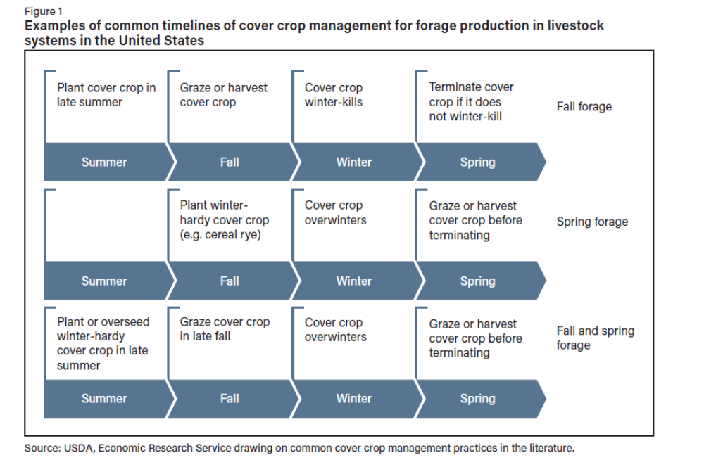

Slide 4
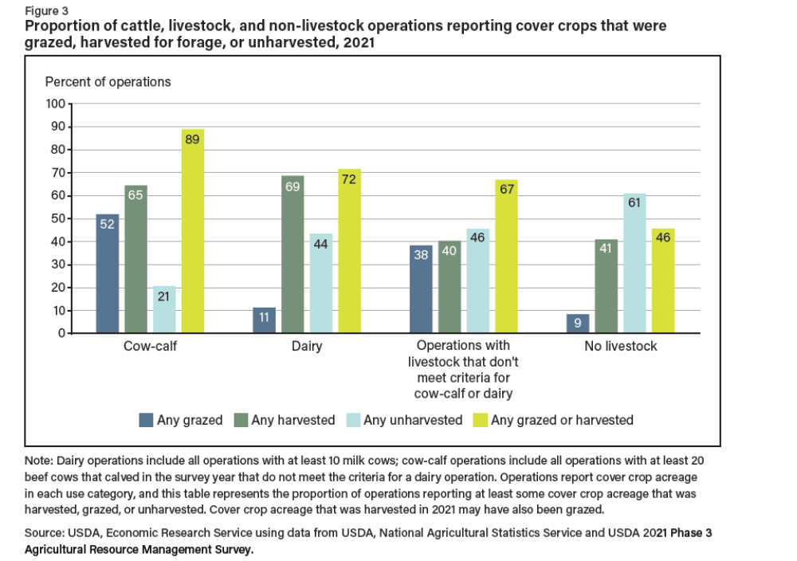

Slide 5
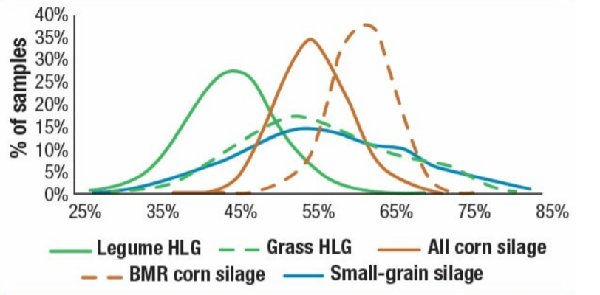
Species Selection
Quality potential of other forage types

Slide 6
12 Month Cropping System for CoverCropping
Spread Manure / soil test
Plant Corn 95 RM
Harvest corn
January | February | March | April | May | June | July | August | September | October | November | December
January | February | March | April | May | June | July | August | September | October | November | December
Interseed planting of cover crop
Interseed planting of cover crop
Fall planting of cover crop

Slide 7
Harvest Dates of Corn

Slide 8
Cover Crop Planting
Spread Manure / soil test
Plant Corn 95 RM
Harvest corn
January | February | March | April | May | June | July | August | September | October | November | December
January | February | March | April | May | June | July | August | September | October | November | December
Interseed planting of cover crop
Interseed planting of cover crop
Fall planting of cover crop

Slide 9
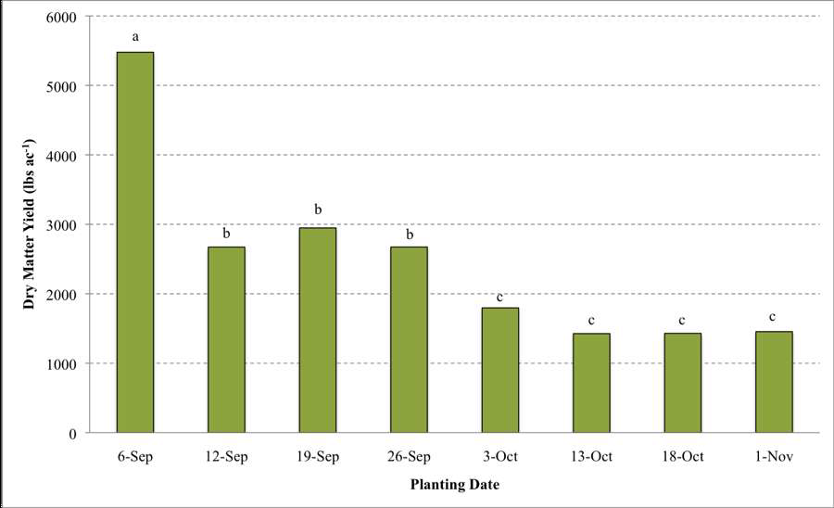

Slide 11
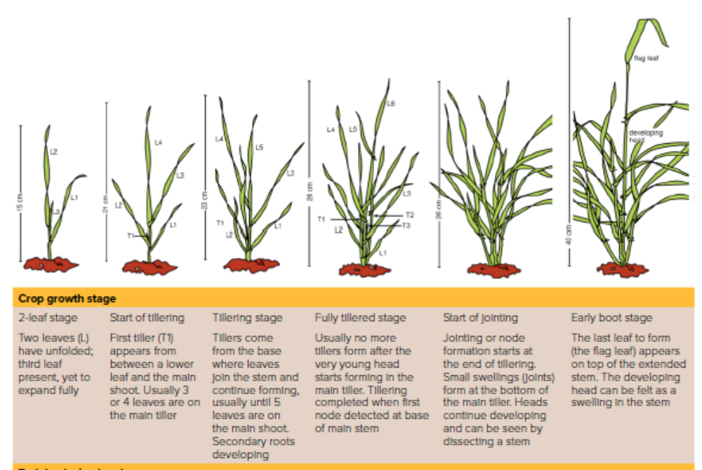
Cereal Rye - Northeast
Rye is planted in the fall
Rye germinates at temperatures from 33 to 41 F
Tiller development vigorous in the fall
4 to 6 weeks growth or 3 to 4 inches of growth
Freezing temperatures required for vernalization 40 – 60 days
Half of its yield comes from tillers

Slide 12
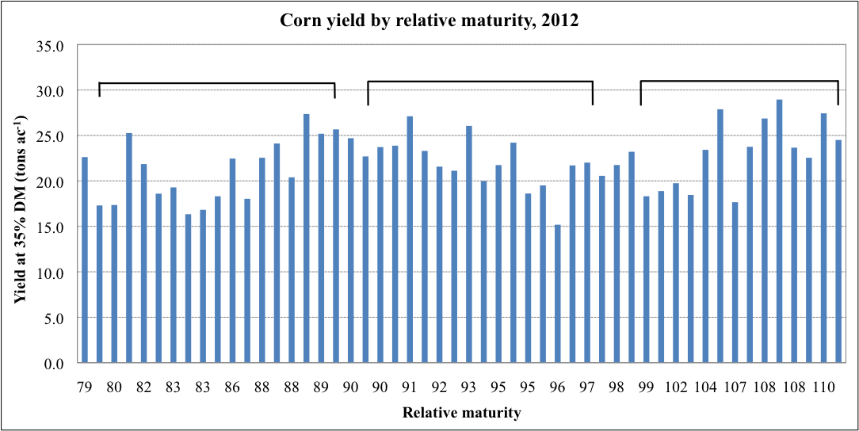
Planting Date – May 22
Planting Date – May 16
September 7
September 17
October 2

Slide 13
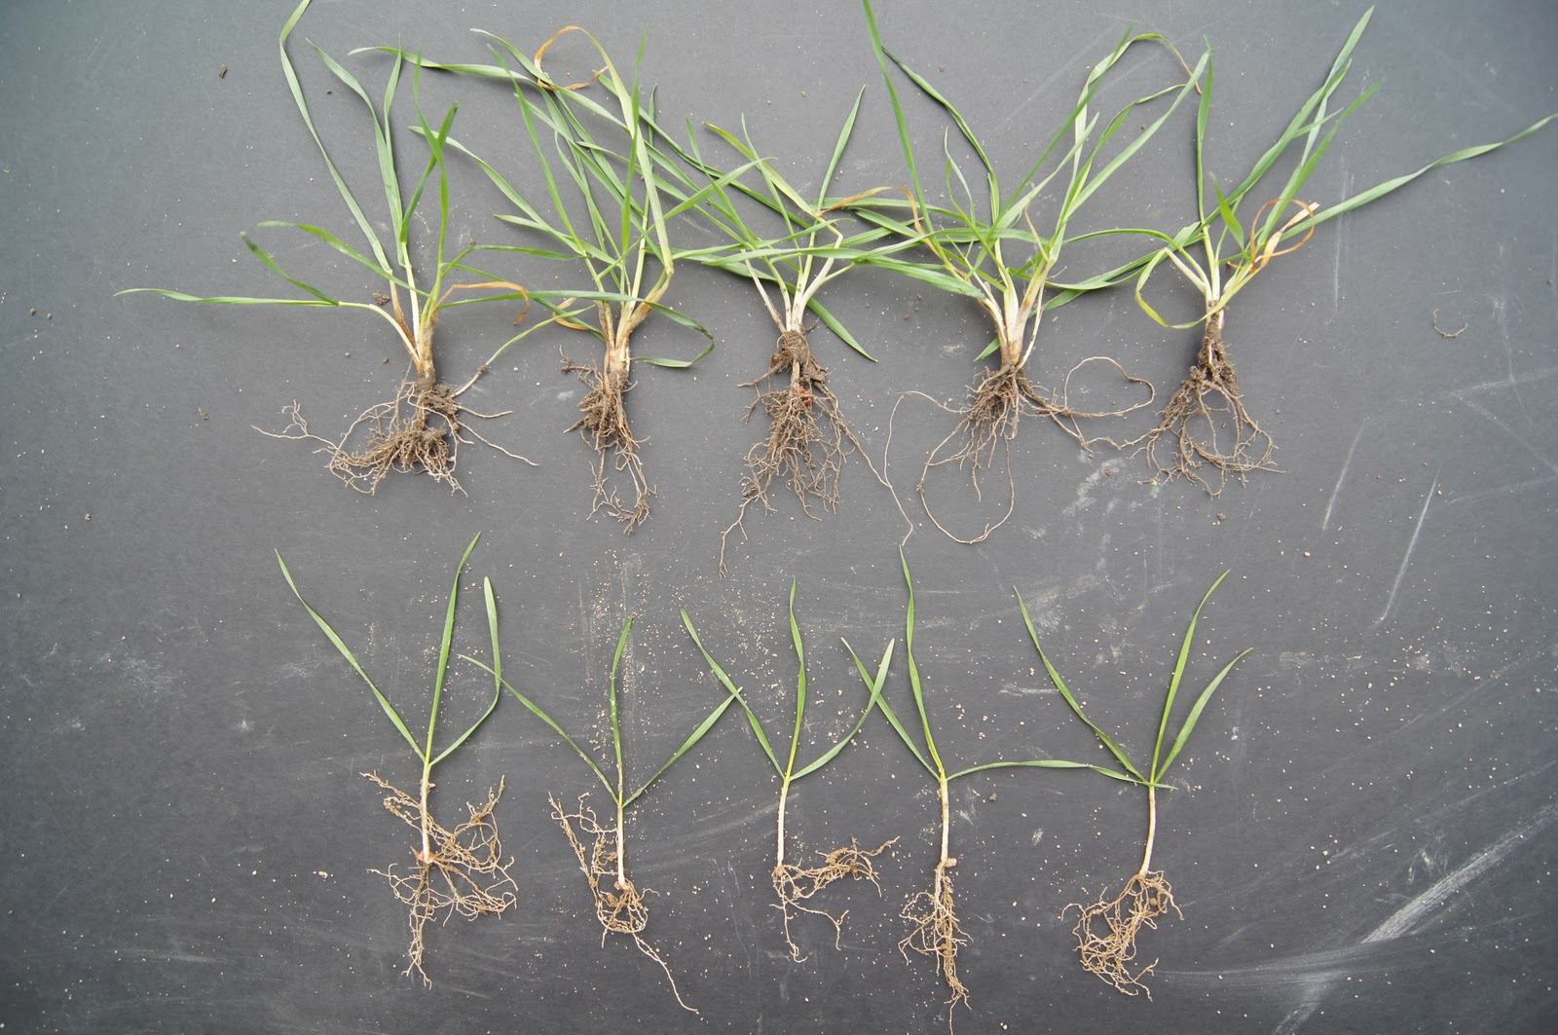
Tillers can account for 60% of yields!

Slide 14
Planting Date Impacts Tiller Development

Slide 15
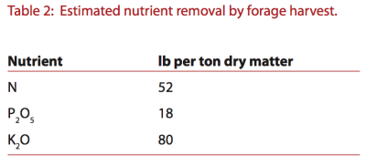
Nutrient Management
Subsequent Crop
Removal of crop and nutrients need to be accounted for in NMP.
Can use forage test to determine nutrient removal.
Cover Crop
Prior to planting or after emergence.
Should use NMP to determine crop needs.
Have seen response to additional N.
NY study showed 50 lbs/N at dormancy break most economical return. (Lyons, et al., 2019)
Estimated nutrient removal of rye harvest.

Slide 16
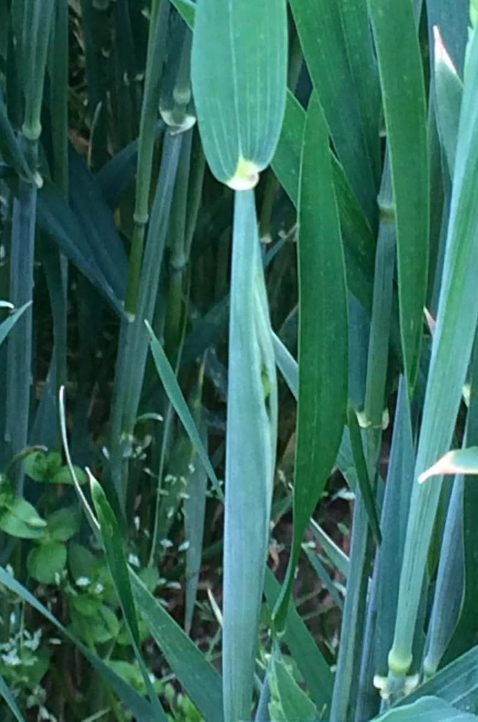
Harvest Timing
2 to 3 days flag leaf to boot stage.
Select species and/or variety to match timing of harvest desired.
Winter rye matures 7 to 10 days earlier than wheat and triticale.
Winter rye, wheat, and barley varieties can vary in heading timing by as much as 10 days under the same conditions.

Slide 17
Winter Rye Heading Dates
Variety | Boot stage harvest date
ND Gardener | 5/9/2024
Spooner | 5/9/2024
Aroostook | 5/9/2025
Danko | 5/13/2024
Covermax | 5/16/2024
Hazlet | 5/16/2024
Progas | 5/16/2024
Receptor | 5/16/2024
Serafino | 5/16/2024
Tayo | 5/16/2024

Slide 18
Harvest stage | DM† at harvest | DM yield | Forage quality characteristics
 |  |  | CP | NDF | NDFd
 | % | kg ha⁻¹ | % DM |  | % NDF
Boot (Feekes 10) | 14.8‡ | 2275 | 19.2 | 44.4 | 64.1
Milk (Feekes 10.54 – 11.1) | 27.5 | 6366 | 10.2 | 59.5 | 51.1
Soft Dough (Feekes 11.2) | 26.3 | 6535 | 10.0 | 54.9 | 47.0
LSD‡ (p=0.10) | 1.32 | 369 | 0.54 | 1.57 | 1.70
Dry matter yield and forage quality characteristics of cereals at various harvest stages.

Slide 19

Winter Rye Forage Yields

Slide 20
Winter Rye Cover Crop

Slide 21
Cover Crop Type & Forage
Small grain | DM yield | Forage quality characteristics
 |  | CP | NDF | dNDF
 | lbs/ac | % DM |  | % NDF
Graze @ 30.5 cm
Barley | 267 | 21.5 | 32.5 | 85.7
Triticale | 1887 | 17.3 | 38.8 | 83.3
Wheat | 638 | 18.1 | 38.7 | 84.9
LSD (0.10) | 887 | NS | 2.28 | NS
Graze @ Boot stage (Feekes 10)
Barley | 2968 | 14.1 | 47.0 | 73.2
Triticale | 2791 | 14.9 | 53.2 | 63.2
Wheat | 3906 | 11.8 | 52.3 | 65.1
LSD (0.10) | NS | 1.65 | 1.84 | 1.62

Slide 22
Winter Grain Forages

Slide 23
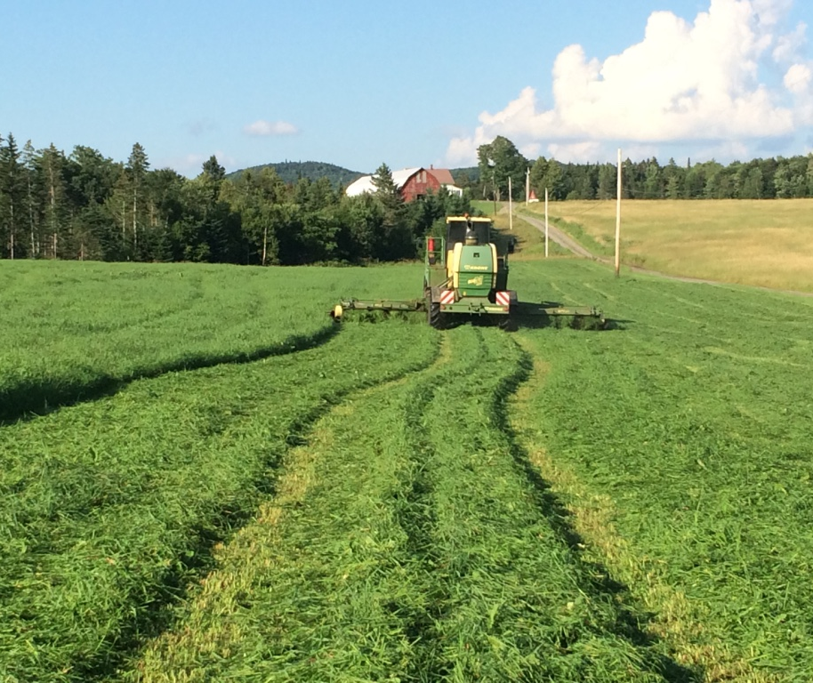
Harvesting for Stored Feed
Risk high ash content
  Mow higher than 4 inches
  Avoid rakes
Dry to proper moisture
  33 to 36%
Silage inoculants
Pack to proper density
  Reduce chop length (0.6 to 1.0 cm)

Slide 24
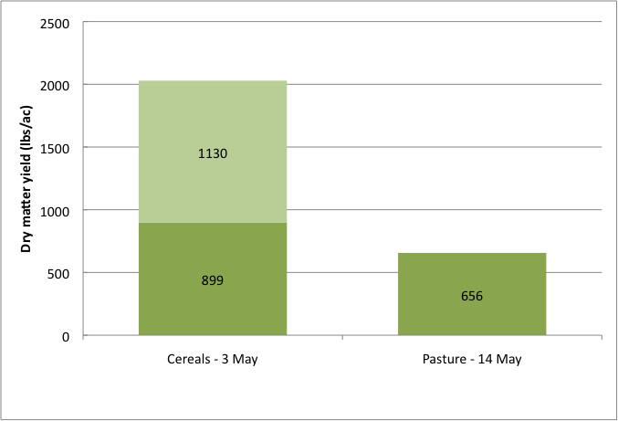
Pasture vs. Cereals

Slide 25
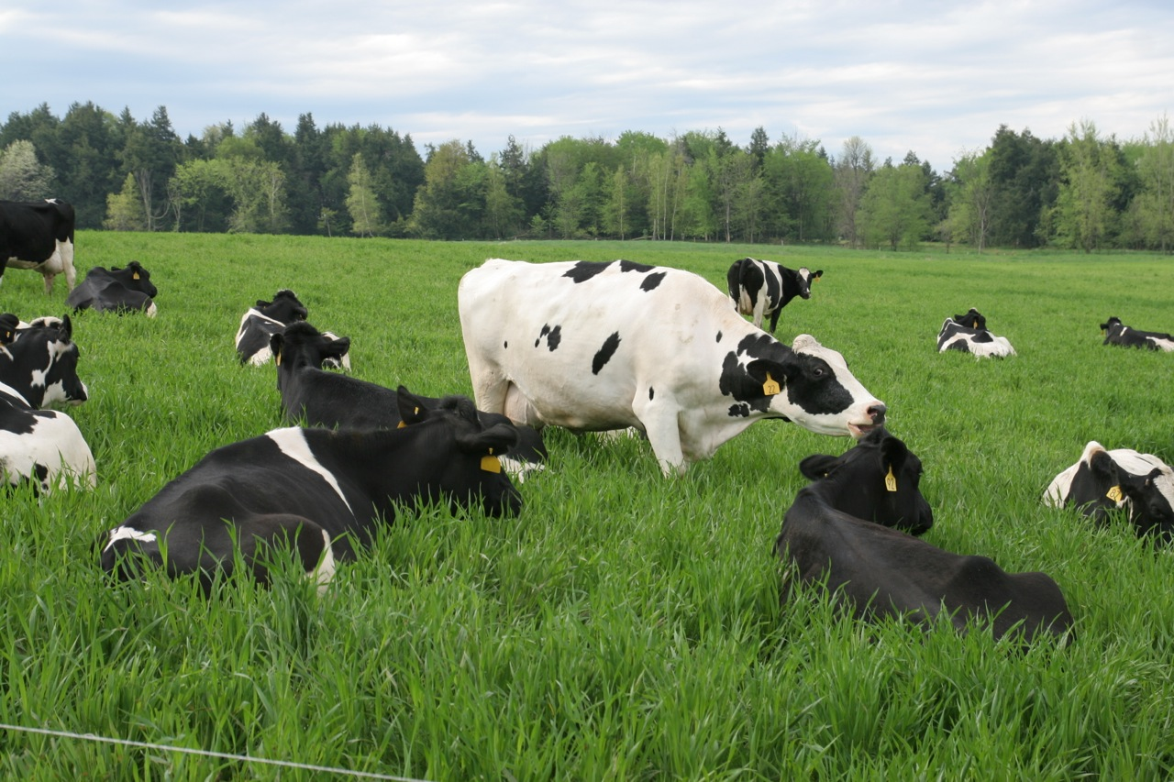

Slide 26
Other Considerations
Herbicide Selection
What are planting restrictions?
What are harvesting restrictions?
Environmental Considerations
Trade-offs cover crop vs forage
Reduce amount of organic matter
Reduce nitrate accumulation
Reduce herbicide use

Slide 27
12 Month Cropping System for CoverCropping
Harvest forage crop
Update Nutrient Management Plan
Plant Corn 94 RM
Inter seed cover crop mix
Harvest corn
Spread Manure / soil test
Corn Seed Fertilizer pre-purchase
Update Nutrient Management Plan
Terminate Cover Crop
Top Dress/side dress
interseed
January | February | March | April | May | June | July | August | September | October | November | December
January | February | March | April | May | June | July | August | September | October | November | December
Assess what fields rotations need to be made, can reduced tillage be part of the plan. Start thinking about where cover crops and other soil building practices could be implemented.
Spread spring manure
Obtain seed blends for cover crop plan
Fall planting of cover crop
Design cover crop plan for fields.
Assess status of stand planted last year
Spray herbicide depending on cover corp strategy
Spread manure on to 6-8 inch established cover crop. Manure injection on cover cropped fields also works well.

Slide 29
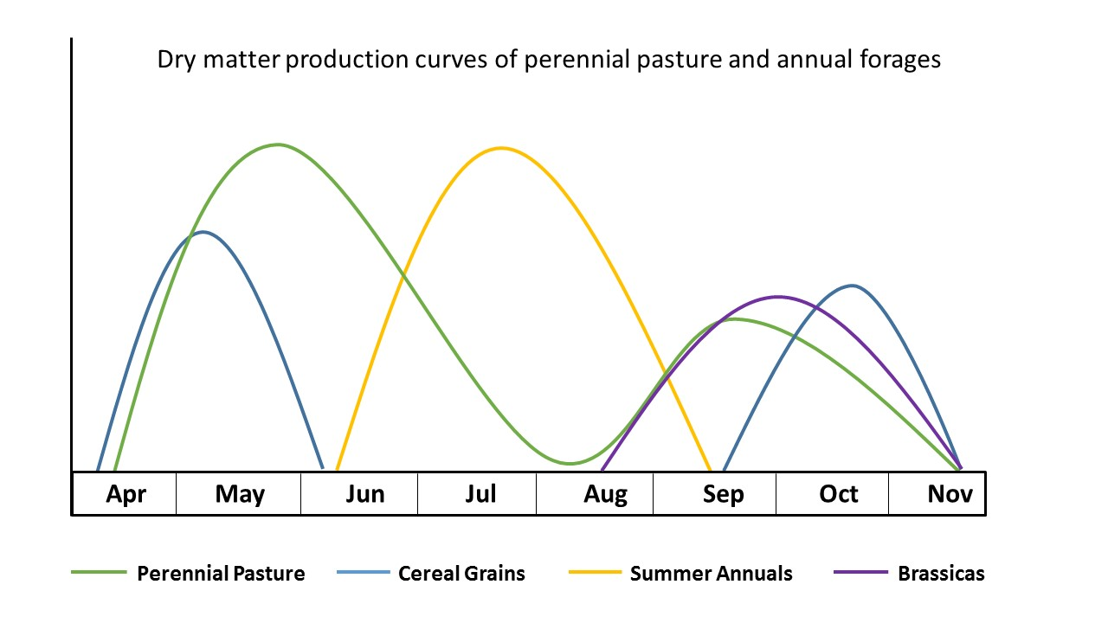
Notes:
The graph really illustrates how annual forages can help fill in and supplement the gaps left by our cool season perennials. These may be grown by themselves as a forage crop or integrated into other cropping systems on the farm as a cover crop or a crop in between pasture/hay field rennovations. They can also help extend the grazing season on either end of the season and take pressure off of perennial pastures during the summer slump when their regrowth periods are extended. This may be particularly important for organic dairy producers who are required to meet an average of 30% of their animals’ dry matter intake from pasture over 120 day grazing season. If your pastures really shouldn’t be grazed but you have no where else for the animals to go and are tight on hitting these marks, you may put the animals out too soon and do damage to your pastures. If you have annuals available to graze it can help add acreage to your grazing system at this challenging time, avoiding pasture damage. You may also already be using some crops that could function as a forage crop for another purpose on your farm, namely a cover crop. Managing the cover crop as a forage crop has some additional considerations, but may save you $ as you have already invested in the costs getting it established.

Slide 30
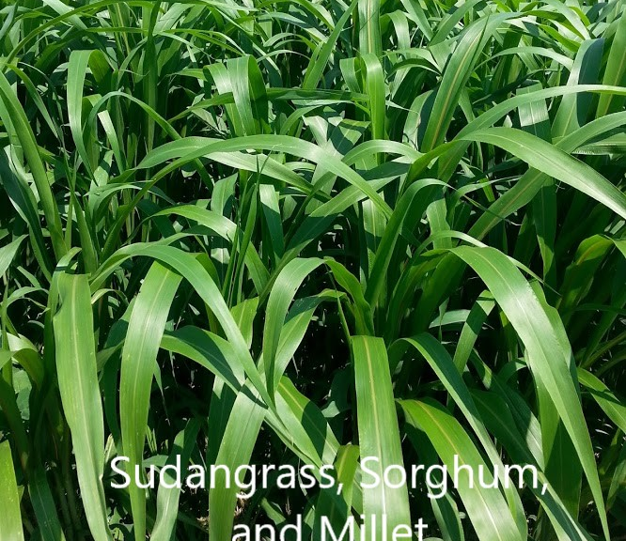
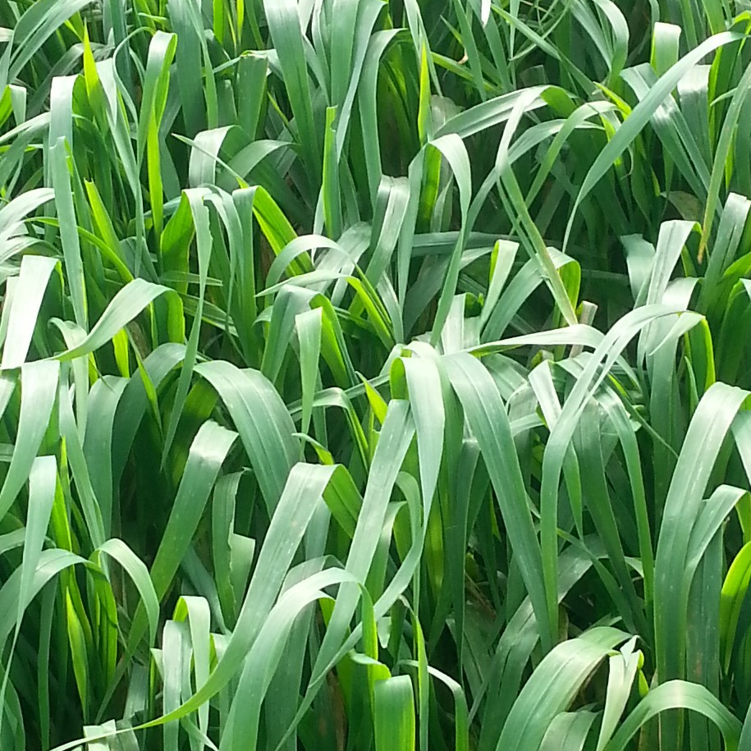
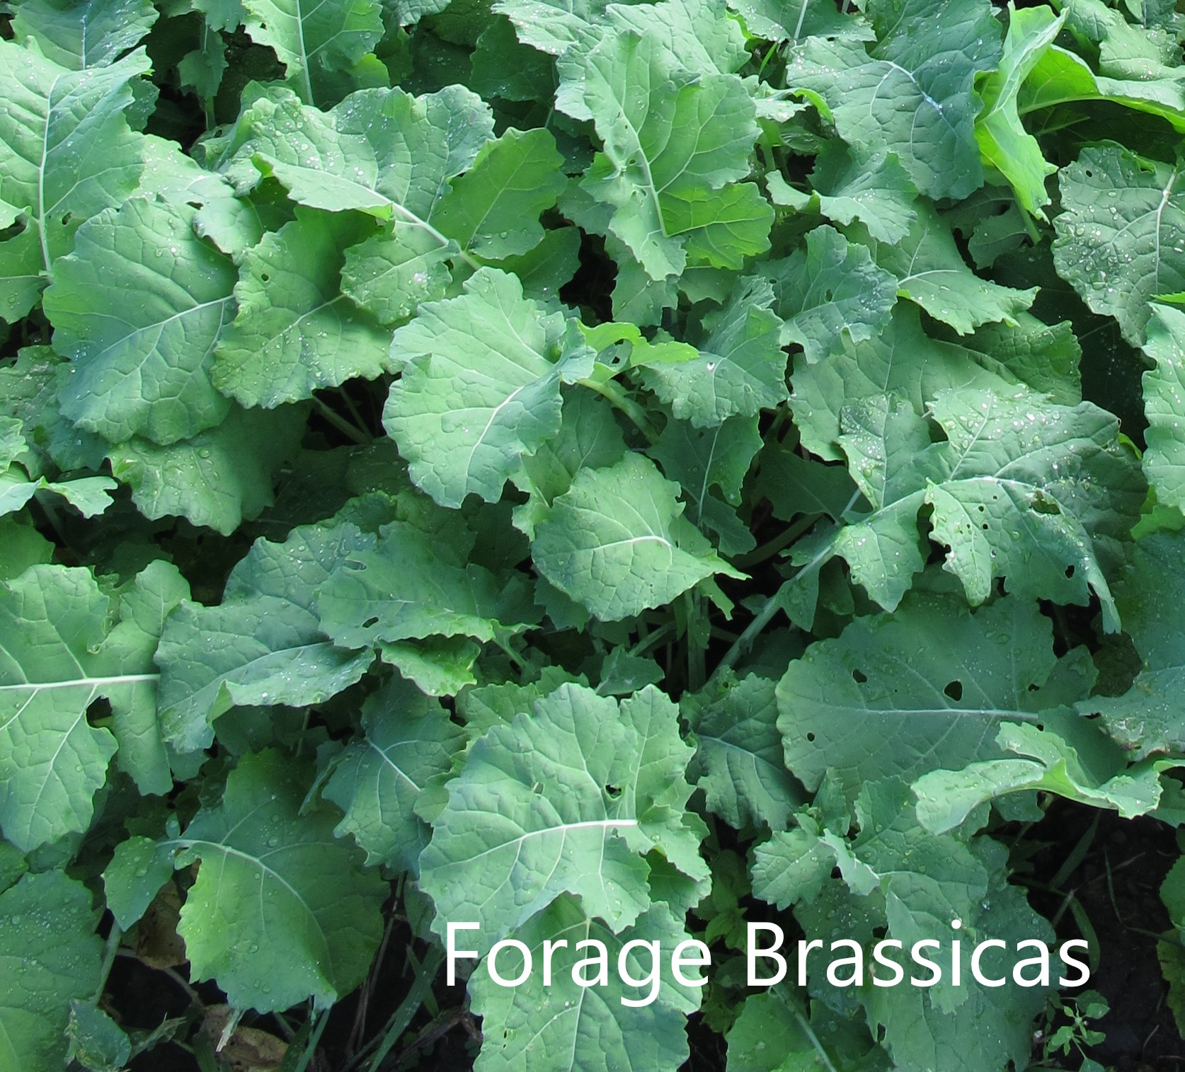
Annual Forages
Summer
Summer annuals- Sudangrass, pearl millet, sorghum
Plant in early-mid June
Dry matter yield 2 - 5 tons/ DM acre
Very drought tolerant
Cool
Cool season annuals- oats, triticale, etc
Plant mid-August
Dry matter yield 1 – 2 tons/ DM acre
Winter
Winter grains- Winter rye, triticale, winter wheat
Plant by late September, overwinter to next spring
Dry matter yield 1.5-2.5 tons/acre in the spring

Slide 31
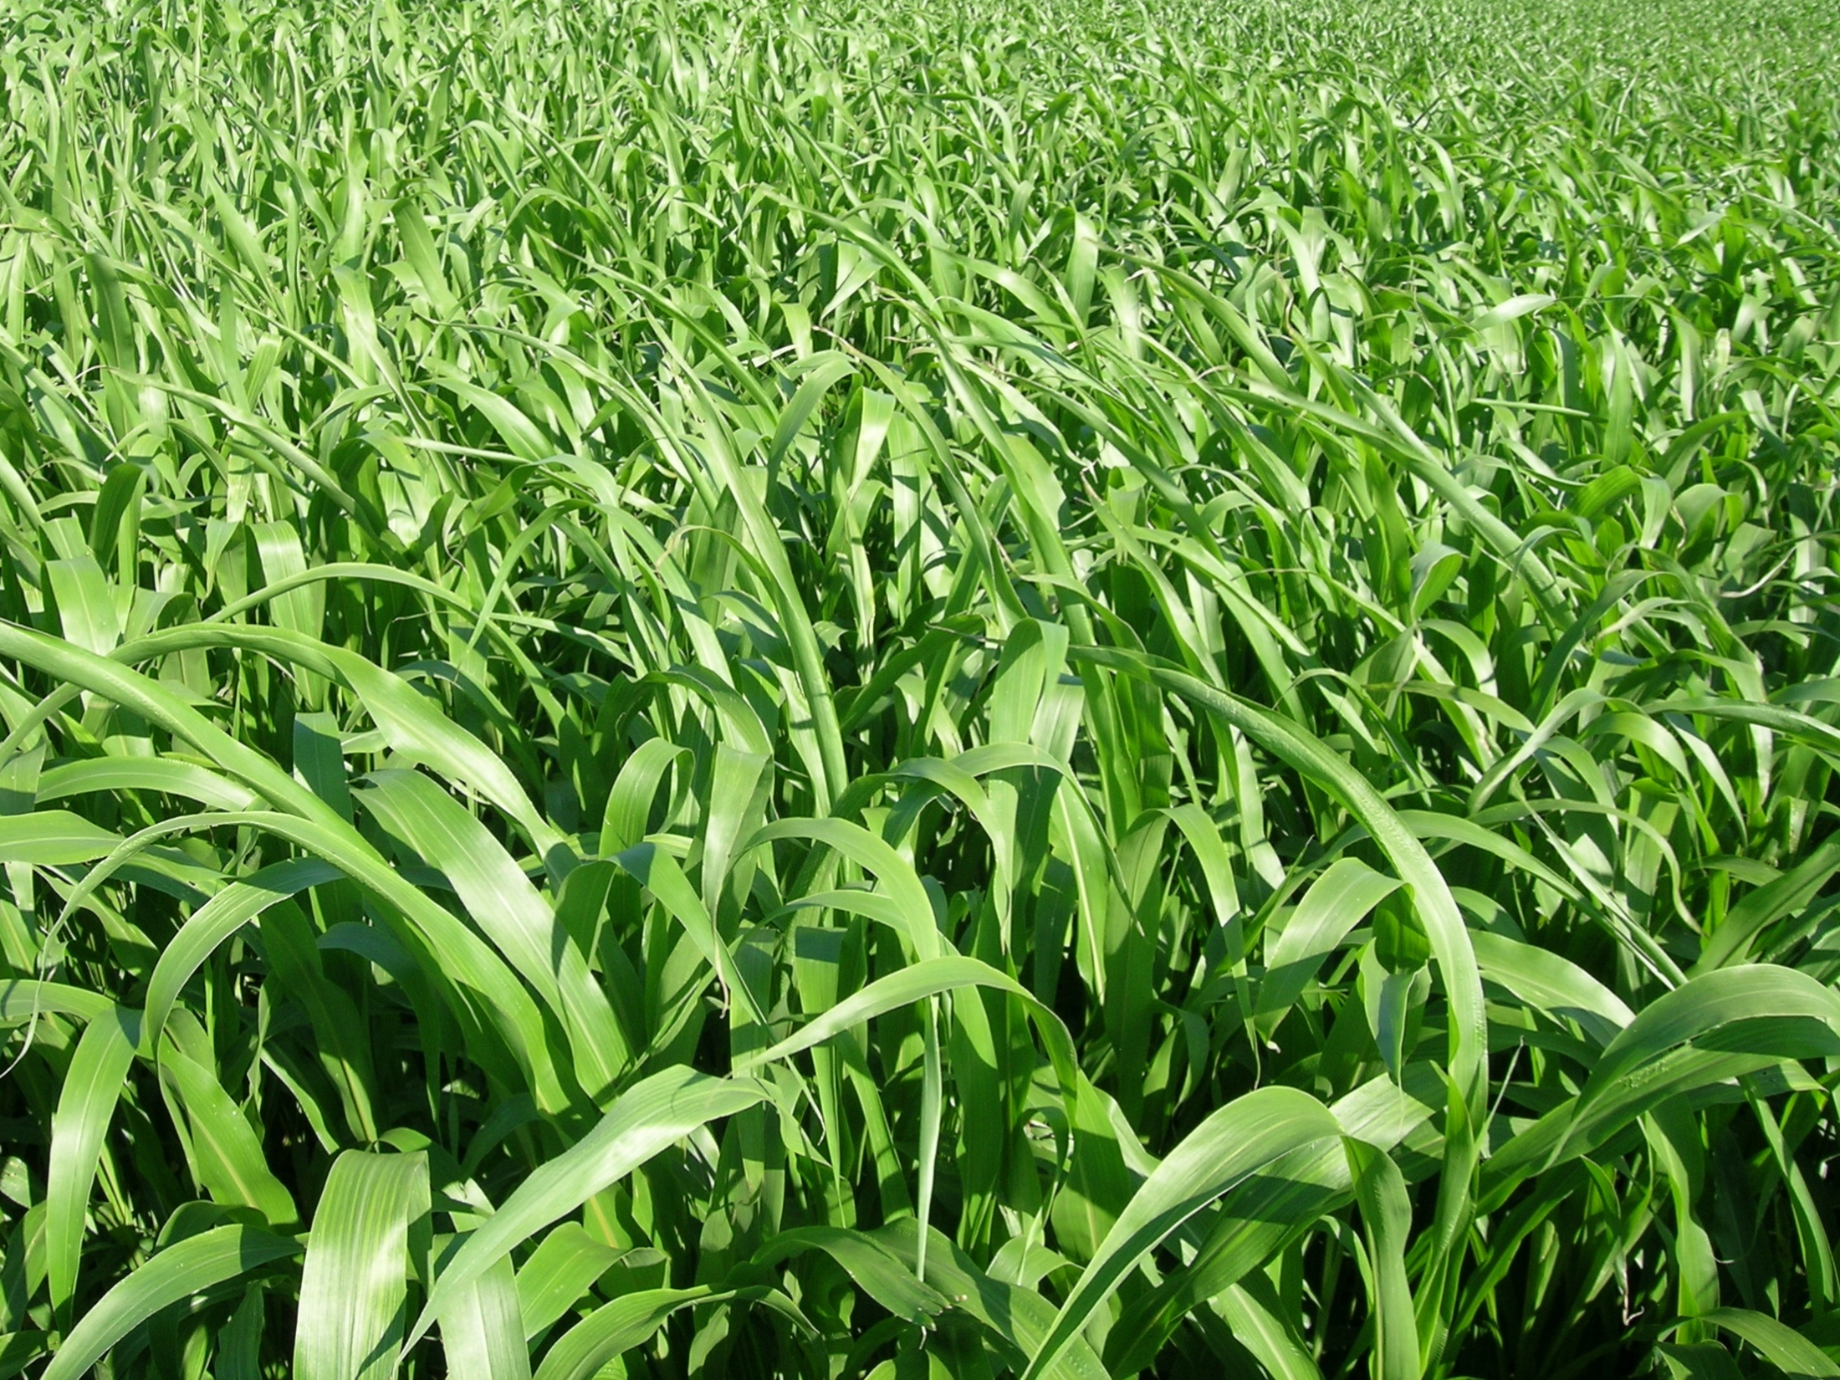
Cool Season Annuals
Small grains for winter cover crops
  Triticale alone on fields renovated in late summer
  One Graze in spring before reseeding
  Early feed if weather cooperates
  Worse case scenario green manure
  Reasonable dry matter for early feed
  Good quality
  Cows like to graze very palatable

Slide 32
Spring and Winter Cereal Crops
Oats & Triticale in late summer (middle of August)
Same as planting triticale – higher seeding rate 150 lbs/acre
Planting two crops one for fall and one for spring grazing
Graze oats in fall – Planted Aug. 19th and grazed first of Oct.
High quality and palatable -Of all annuals cows milk best on oats
Same rotation – graze triticale in spring and reseed

Slide 33
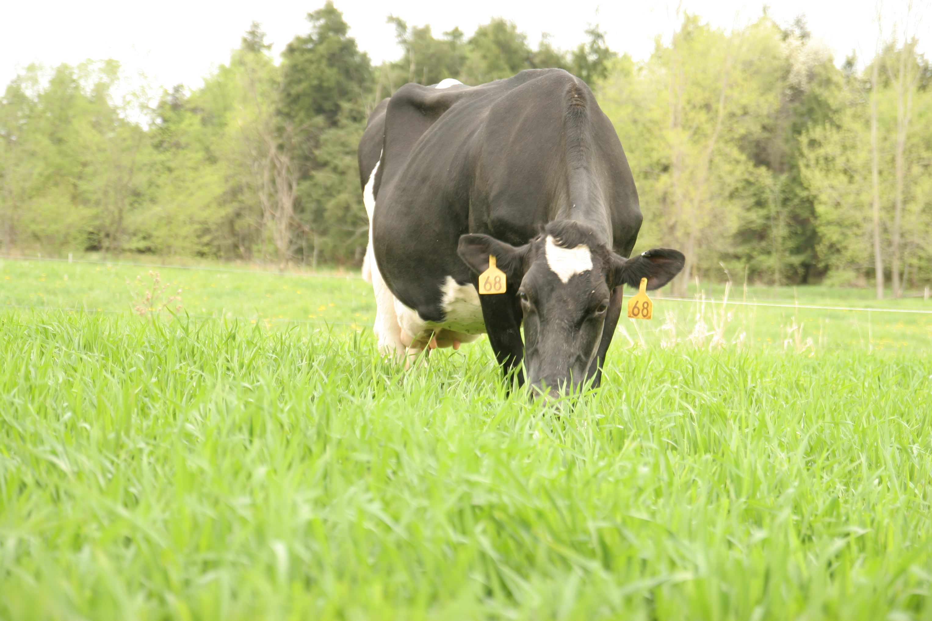
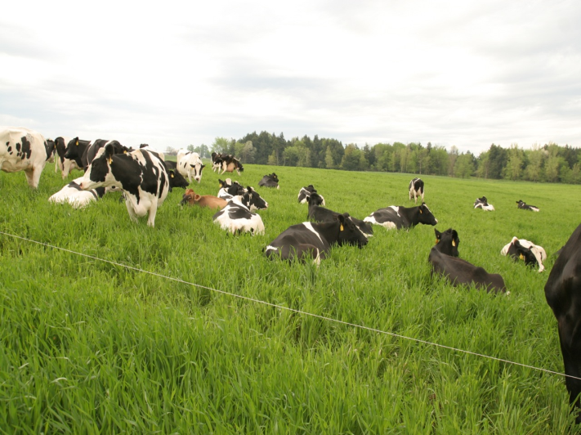
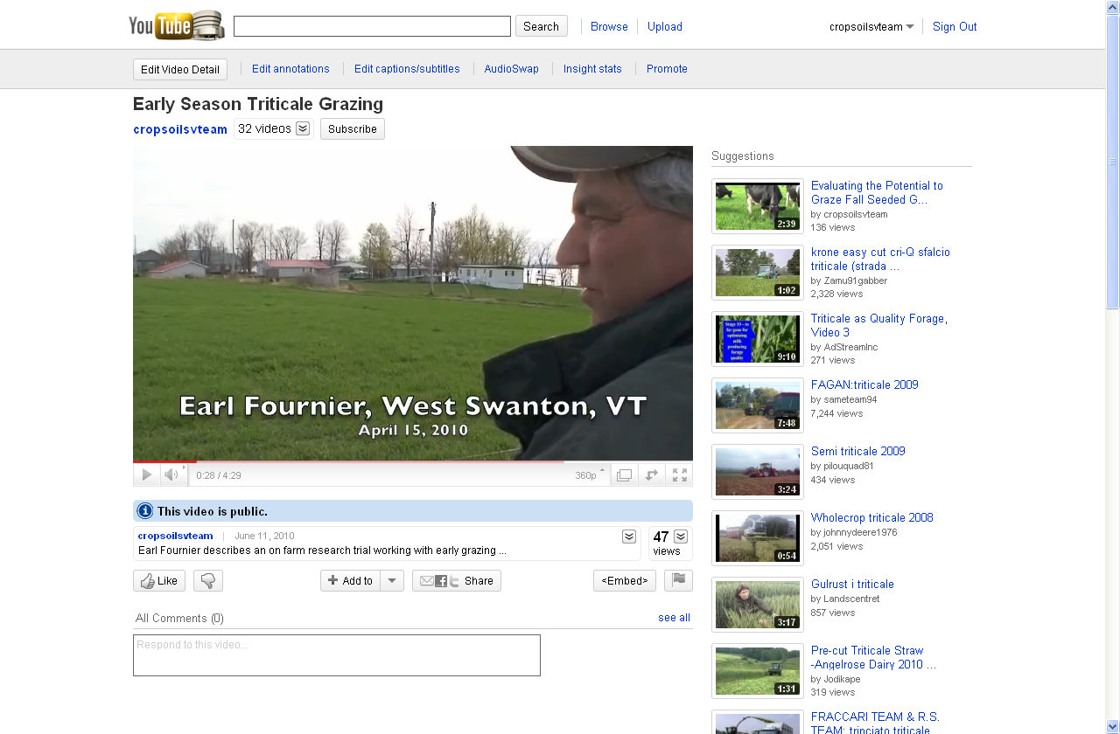
Grazed Triticale
Triticale | DM | DM Yield | Forage Quality Characteristics
 |  |  | CP | NDF | dNDF | NEL
 | % | lbs/acre | % | % | % | Mcal
Grazed | 21.8 | 1350 | 19.4 | 48.5 | 70.6 | 0.71

Slide 34
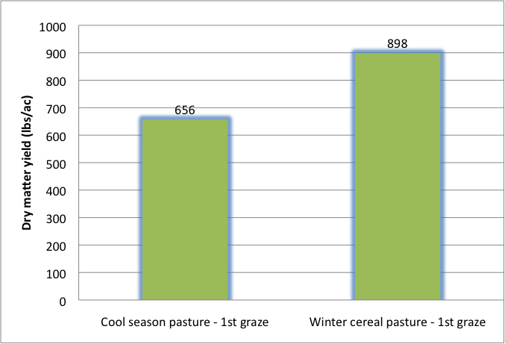
Pasture vs. Cereals

Slide 35
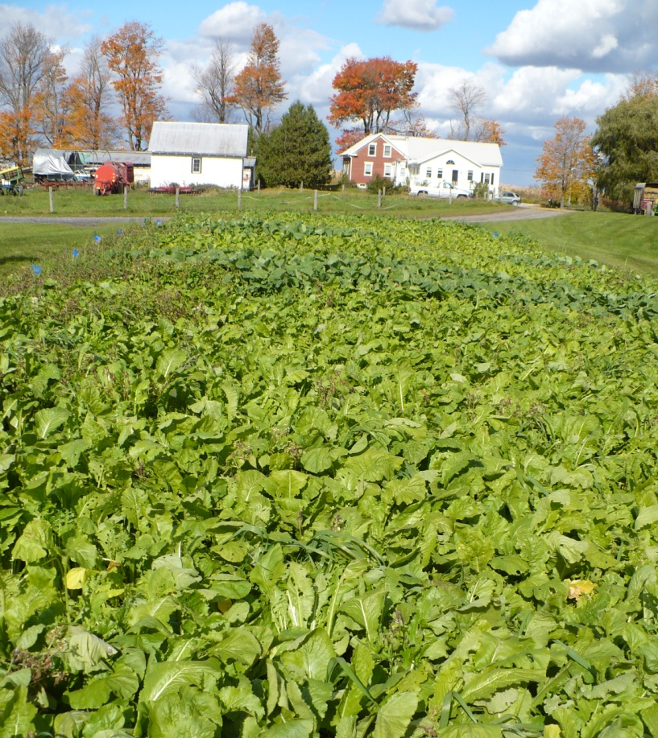
Fall Seeded Brassica
Seeded in mid- August
5 lbs per acre seeding rate
Mid-September 10 inches in height
Harvested in mid-October
Potential for multiple harvest times
At harvest 2 to 3 feet in height

Slide 36
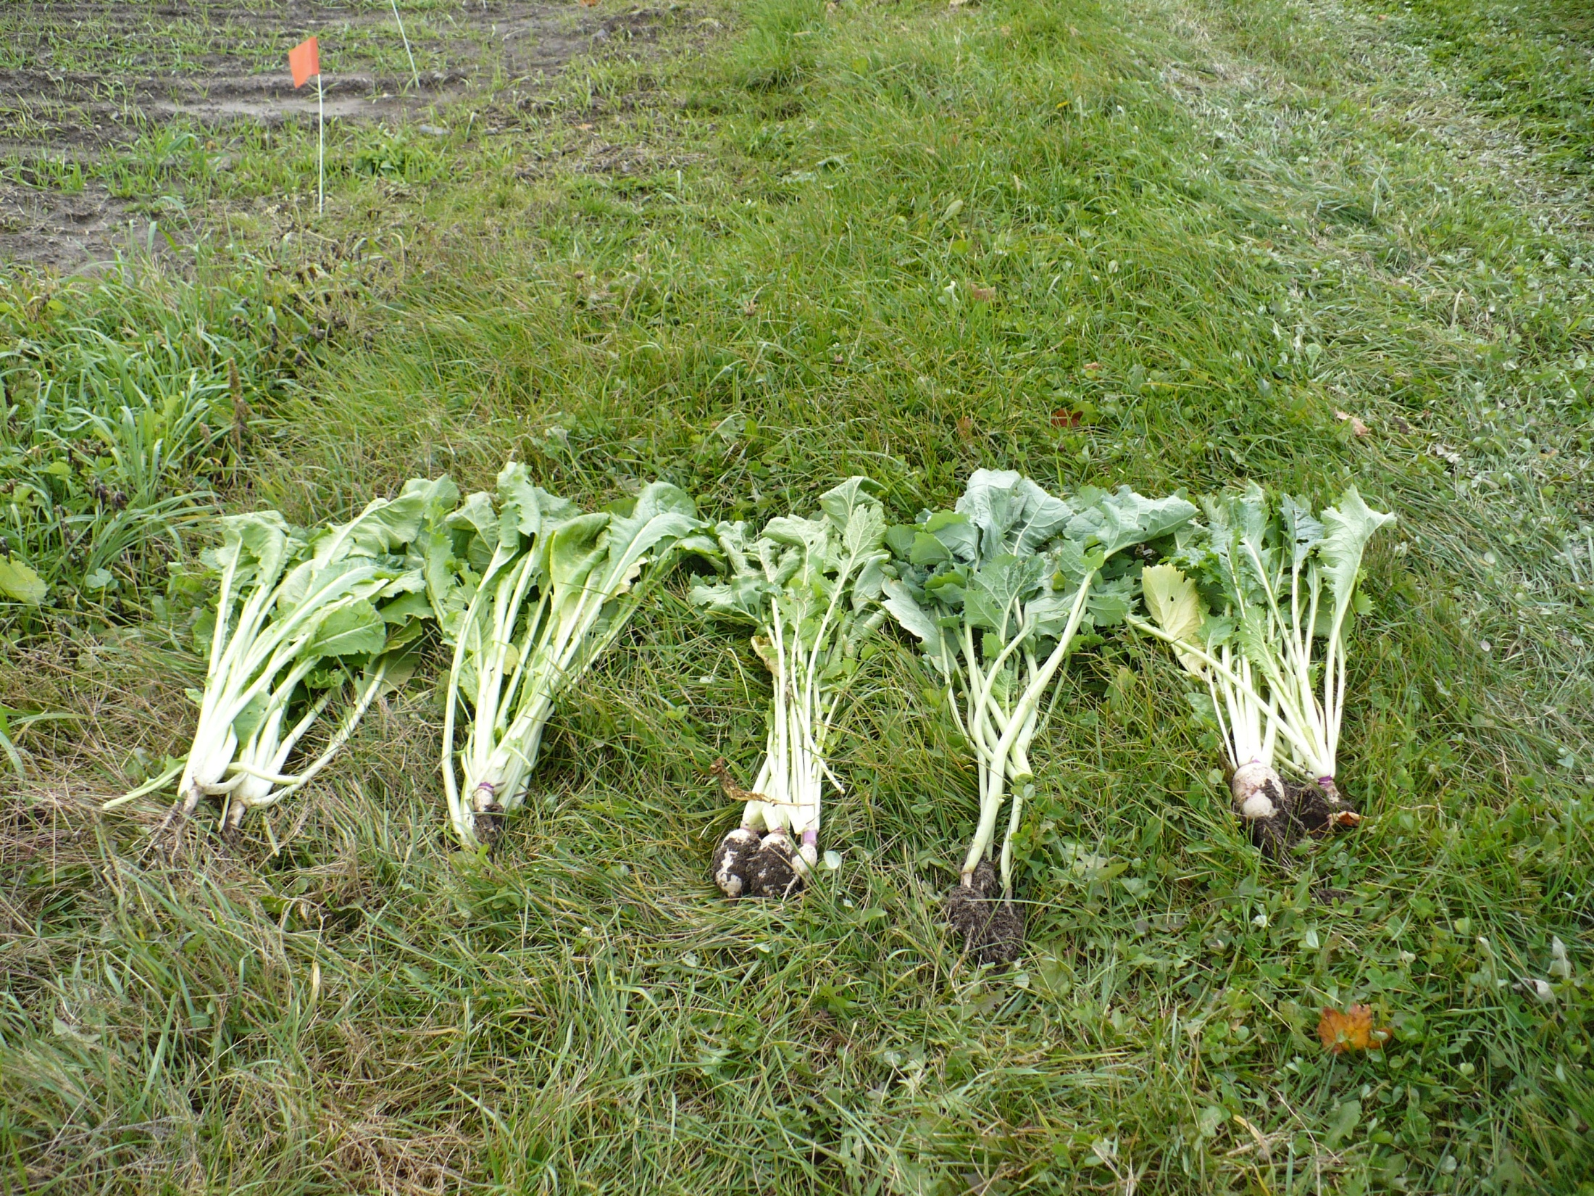
T-raptor Pasja Barkant Bonar Appin

Slide 37
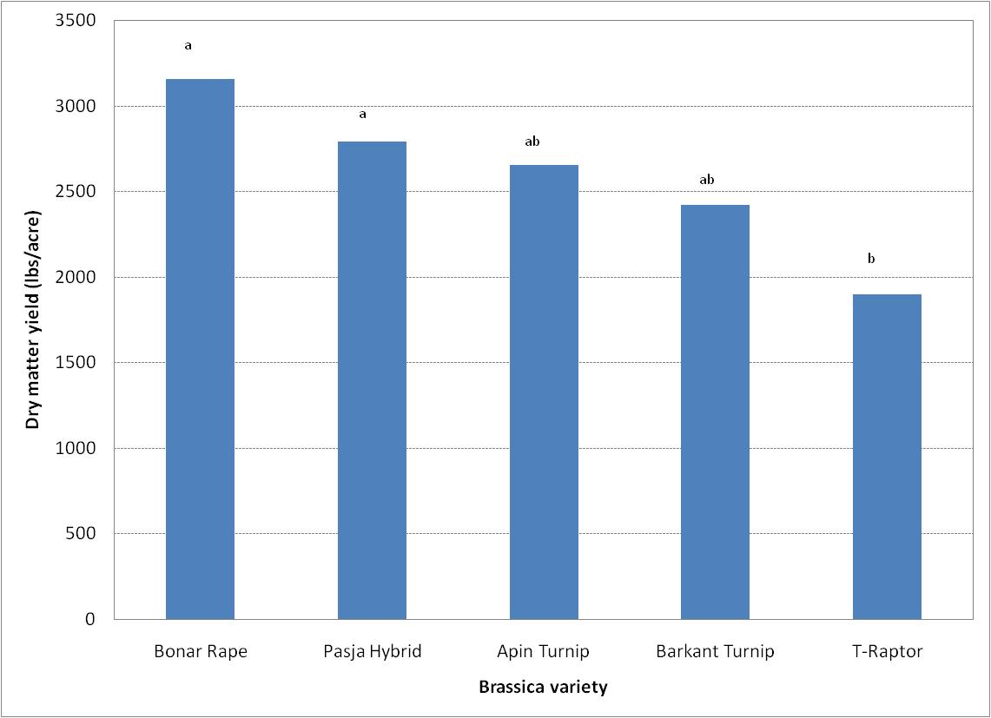

Slide 38
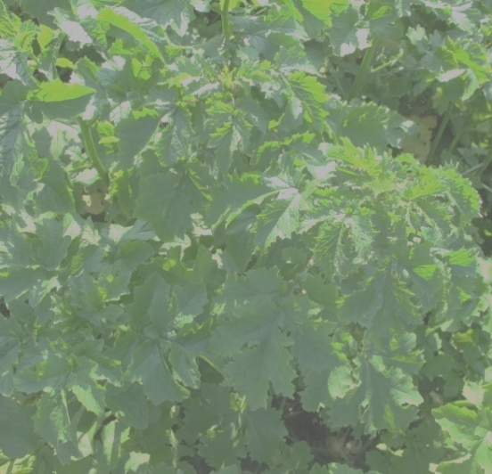
Forage Brassicas Average Yields

Slide 39
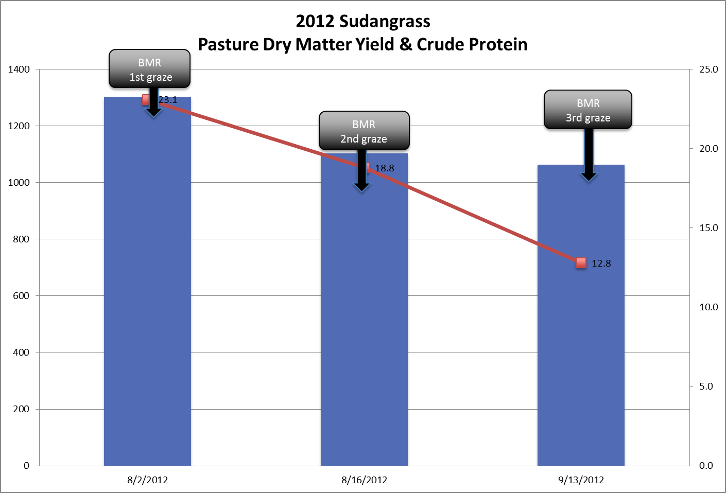

Slide 40
Pasture Comparison - August
Perennial Pasture
CP = 16.4%
NDF = 53%
dNDF = 59.7%
NEL = 0.64 Mcal
TDN = 61.6%
BMR Sudangrass
CP = 18.8%
NDF = 59%
dNDF = 70.3%
NEL = 0.69 Mcal
TDN = 66.1%

Slide 41
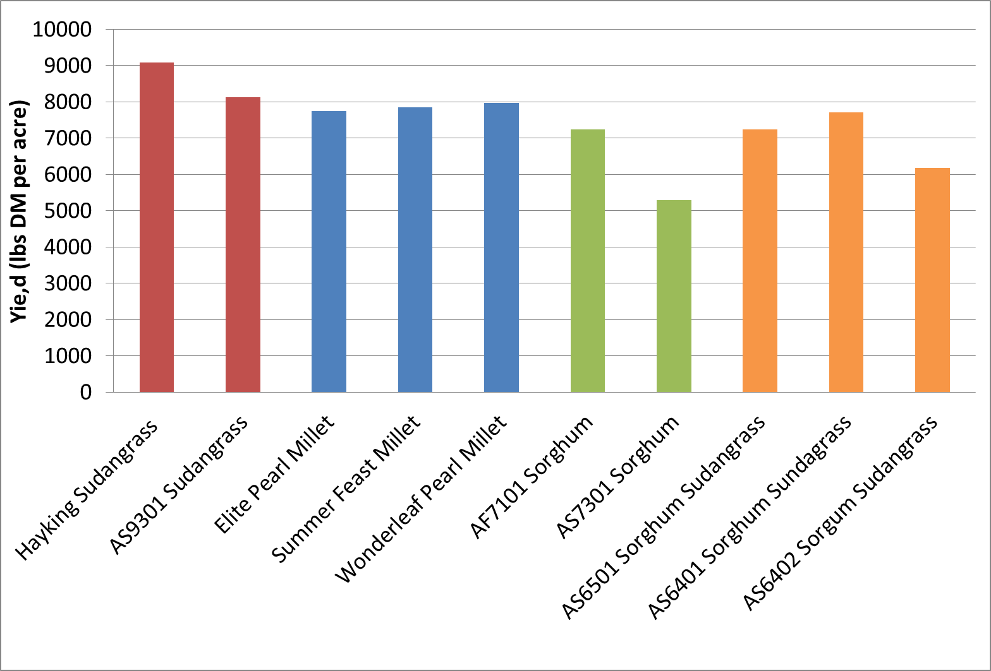

8609 lb/A
8609 lb/A
7852 lb/A
6268 lb/A
7040 lb/A
Borderview Research Farm, Alburgh, VT

Slide 42
